Slide 1
Graph
SURESH RAJ SHARMA|DATA STRUCTURE AND ALGORITHM

Slide 2
Graph Algorithm
A graph G is a collection of two sets V& E where V is collection of vertices v₀, v₁,……….v_{n-1} also called nodes and E is the collection of edges e₁,e₂,……e_{n} where edge is an arc which connects two nodes. This can be represented as
G=(V,E)
V(G)=(v₀, v₁,……….v_{n-1} ) or set of vertices
E(G)=(e1,e2…….en) or set of edges

Slide 3
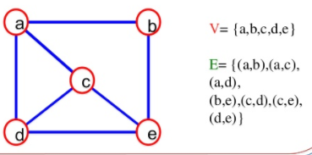
Cont..
A graph can be of two types:
Undirected graph
An graph, which has unordered pair of vertices is called undirected graph, suppose there is an edge between a &b then it can be represented as (a,b)or (b,a) also.

Slide 4
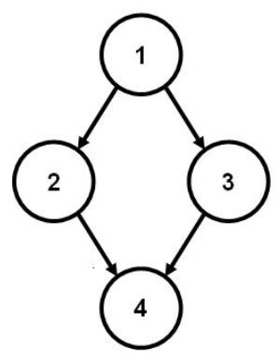
Cont..
2. Directed Graph- a directed graph or digraph is graph which has ordered pair of vertices <v1,v2> where v1 is the tail and v2 is the head of edge. In this type of graph each edge has direction means <v1,v2> and <v2,v1> will represent different edges.
V(G)={1,2,3,4}
E(G)={<1,2>,<1,3>,<2,4><3,4>}

Slide 5
Weighted graph, adjacent node,
Weighted graph:- a graph is said to be weight if it’s edges have been assigned some non negative values as weight. A weighted graph is also known as network.
Adjacent nodes:- A node u is adjacent to another node or is a neighbor of another node v if there is an edge from node u to node v. in undirected graph if (v0,v1) is an edge then v0 is adjacent to v1 is adjacent to v0.

Slide 6
Incidence, path, length of path:
Incidence:- in an undirected graph the edge (v0,v1)is incident on nodes v0 and v1. in a digraph the edge <v0,v1>is incident from node v0 and is incident to node v1.
Path: a path from node u0 to node un is a sequence of nodes u0,u1,u2,u3……un-1,un such that u0 is incident to u1 , u1 is incident to u2 ……… un-1 is incident to un. In other words we can say that (u0,u1),(u1,u2)………(un-1,un).
Length of path: length of path is the total number of edges included in path.

Slide 7
Closed path, simple path
Closed path: a path is said to be closed if first and last nodes of the path are same
Simple path: simple path is a path in which all nodes are distinct with an exception that the first and last nodes of the path can be same.

Slide 8
Cycle, cyclic graph, acyclic graph, DAG
Cycle: cycle is a simple path in which first and last node are the same or we can say that a simple closed path is a cycle.
Cyclic graph: a graph that has cycles is called cyclic graph.
Acyclic graph: acyclic graph that has no cycles is called acyclic graph.
Dag: A directed acyclic graph is named as dag after its acronym. Graph G5 is an example of Dag.

Slide 9
Degree, Indegree, Outdegree
Degree: in an undirected graph, the number of edges connected to node is called degree of that node, or we can say that degree of a node is is thee number of edges incident on it.
Indegree: the indegree of node is the number of edges coming to that node or in other words edges incident to it.
Outdegree: the outdegree of node is the number of edges outside from that node or in others words the edges incident from it.

Slide 10
Source, sink and isolated node
Source: a node which are no incoming edges but has outgoing edges is known as source. The indegree of source is always zero.
Sink: a node which has no outgoing edges but have incoming edge is called sink. The outdegree of sink is zero.
Isolated node :if a node has no edge connected with any other node then its degree will be zero, it is known as isolated node.

Slide 11
Connected graph, weakly connected and strongly connected
Connected graph: an indirected graph, is connected if there is a path from any node of graph to any other node, or node is reachable from any other node.
Weakly connected: a diagraph is weekly connected or unilaterally connected if for any pair of nodes u and v, there is a path from u to v and also path from v to u .
Strongly connected: a digraph is strongly connected if there is directed path from any node of graph to any other node.

Slide 12
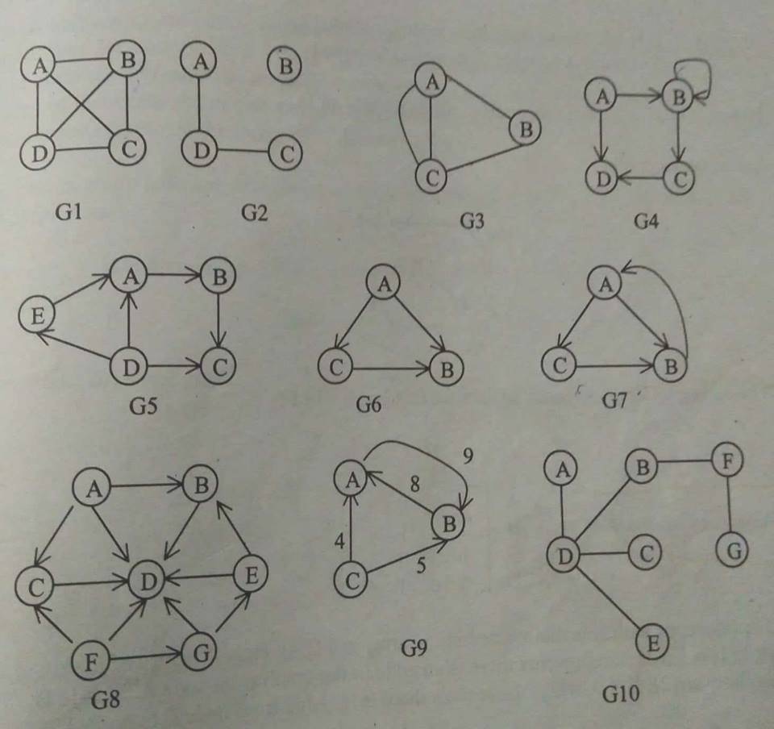

Slide 13
Adjacency matrix
Adjacency matrix is the matrix, which keeps the information of adjacent node. In other words, we can say that this matrix keeps the information that whether this node is adjacent to any other node or not. We represent this matrix in two dimensional array of nxn or array[n][n] where first subscript will be row and second subscript will be column of that matrix.

Slide 14
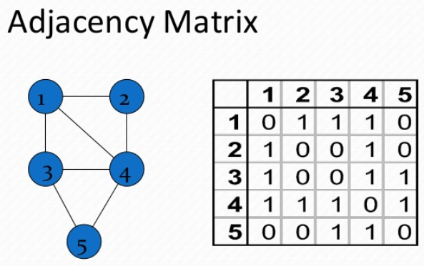
Cont..
Arr[i][j]=1 if there is edge from node I to node j =0 if there is no edge from node I to node j

Slide 15
Weighted Adjacency Matrix
If there is given weight of edge then we replace the 1 with given weight which is known as weighted matrix. It will be represented as
arr[i][j]= weight of edge if there is edge from node I to j
=0 otherwise

Slide 16
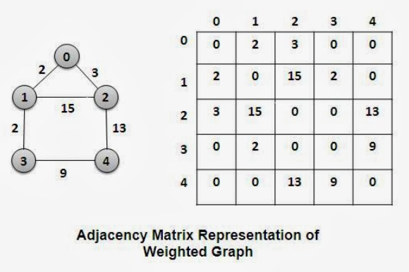
Weight adjacency matrix

Slide 17
Topological sort
A topological sort is an ordering of vertices in a directed acyclic graph, such that if there is a path from vi to vj then vj appear after vi in the ordering. A directed edge (v,w) indicates that course v must be completed before course w may be attempted. A topological ordering of this course is any course sequence that doesn’t violate the prerequisite requirement.

Slide 18
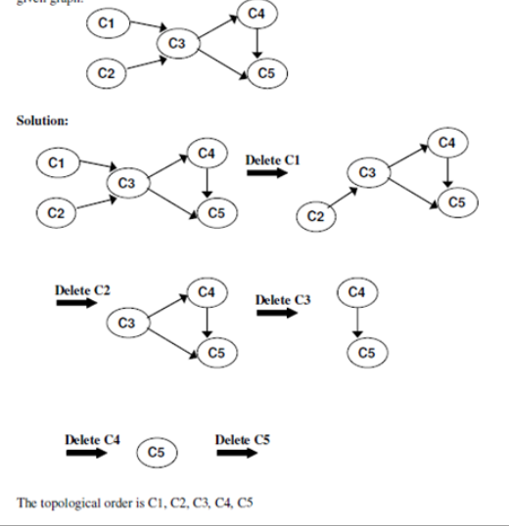
The topological sort order is c1, c2, c3, c4, c5

Slide 19
Traversal in Graph
The traversal of graph indicates that to visit the each node of graph exactly once in the graph. There are two method for traversal of graph.
Breadth First search. (BFS)
Depth First Search. (DFS).

Slide 20
Breadth First search. (BFS)
This graph traversal techniques uses queue for traversing all node of graph. In this first we take a node as a starting node then we take all the node adjacent to that starting node. Similar approach we take for all other adjacent nodes, which are adjacent to starting node and so on. We maintain the status of visiting node in one array so that no node can be traversed again.

Slide 21
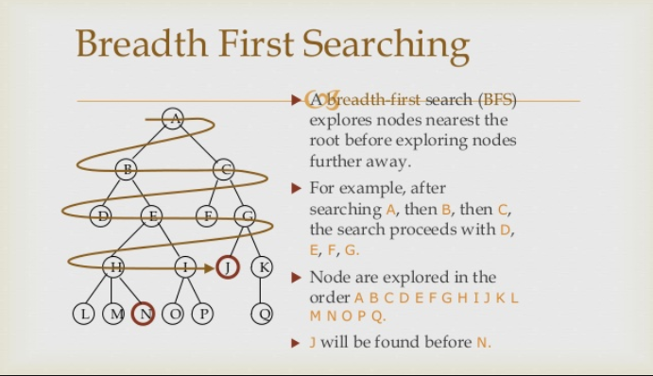
Cont..

Slide 22
Depth First Search. (DFS).
In depth first search technique also we take as a starting node. Then go to the path which is from starting node and visit all the nodes which are in that path. When we reach at the last node then we traversal another starting from the node. If there is no path in the graph from last node then it return to the previous node in the path and traversal another path and so on

Slide 23
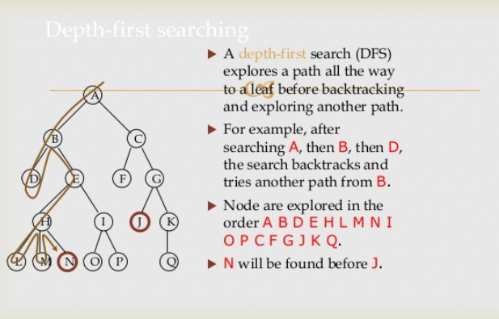
cont..

Slide 24
Shortest path algorithm
The Dijkstra shortest path algorithm is used to find the shortest path from one point to every other points by expanding the adjacent node with the shortest path . It the node is one find the permanent the we scan for the shortest possible path from permanent point to other temporary node as a working node. The node will not repeat and we find the path for every node from the given node,as in figure below.

Slide 25
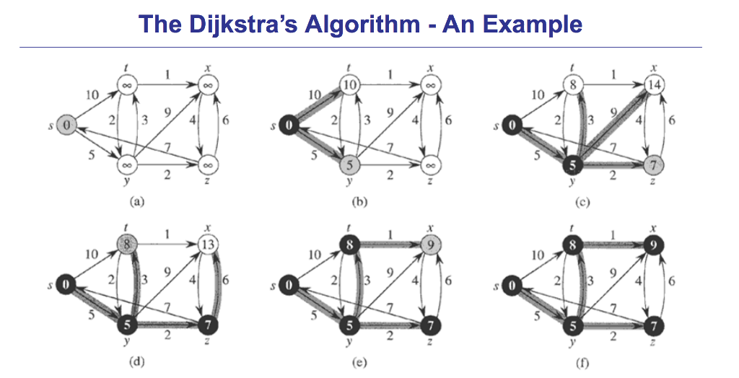
Cont..

Slide 26
Minimum spanning tree
Spanning tree is a connected graph G contains all the node and has the edge, which connect all the nodes, so number of edge will be 1 less than the number of node.
Minimum spanning tree is the spanning tree in which the sum of weight on edges is minimum in given graph.
There are two method for finding minimum spanning tree(MST).
Prime’s Algorithm
Kruskal’s Algorithm

Slide 27
Prim’s Algorithm
In prim’s algorithm, we start with any node and add the other node in spanning tree on the basis of weight of edge connecting ti that node. Suppose we start from a node v1then we have a need to see all the connecting edge and which edge has minimum weight. Then we will add that edge and node to the spanning tree. So here we will be in need to know the nodes in spanning tree and weight on edge connecting to other nodes.

Slide 28
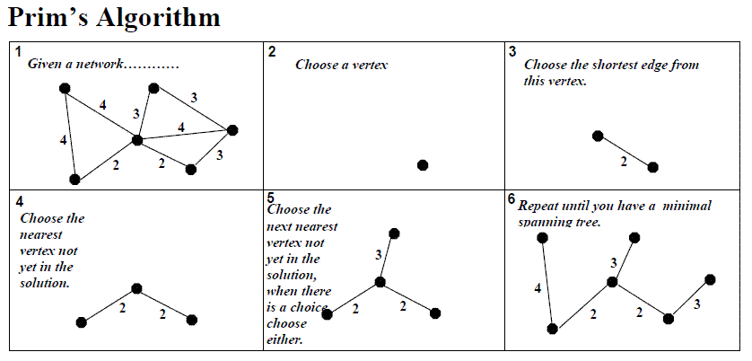

Slide 29
Kruskal’s Algorithm
In kruskal’s algorithm we examine all the edge one by one starting from smallest edge. To decide whether the selected edge should be included in the spanning tree or not, we ‘ll examine the two node connected the edge. It form the MST in the form of forest. It connect the smallest edge and make larger tree after combining all edge given in the graph as shown below.

Slide 30
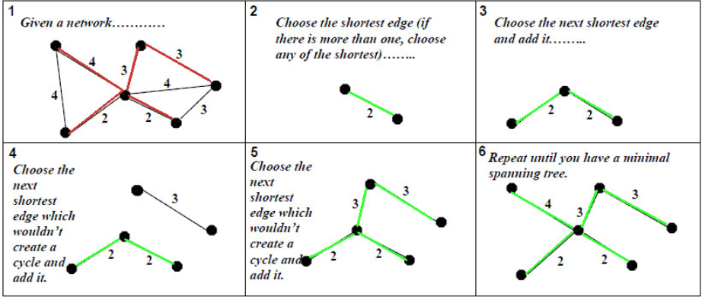
Kruskal’s algorithm

Slide 31
Network flow problem
Suppose we are given a directed graph G=(V,E) with edge capacity C_{v,w}. These capacities could represent the amount of water that could flow through a pipe or the amount of traffic that could flow on a street between two intersections. We have two vertices S, which is called source and t which is the sink. Through out any edge (v,w), at most cv,w unit of flow may pass. At any vertix that is not either s or t , total flow coming in must be total flow going out. If the amount is more or less this is known as network flow problem.

Slide 32
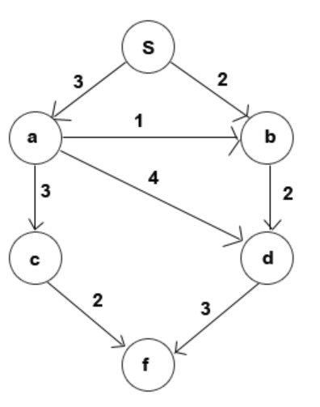
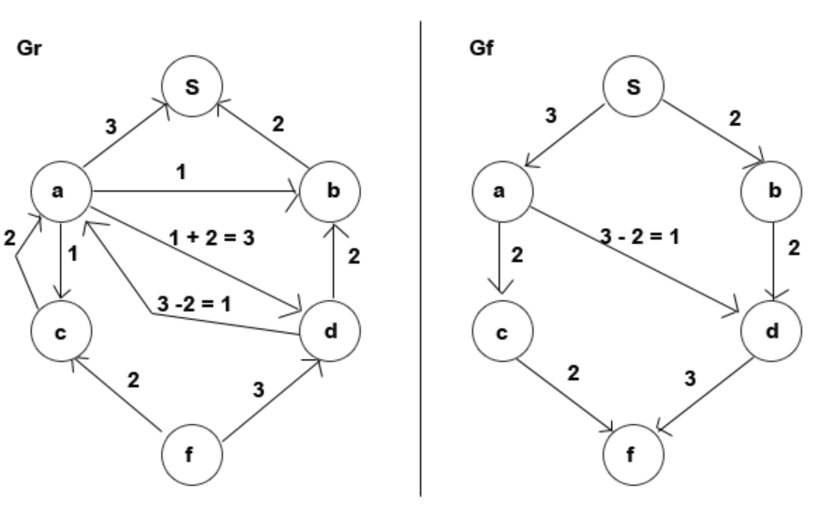
Network flow problem and solution

Slide 33

ANY Query

